Slide 1
CSCI 566: Deep Learning and Its Applications
Jesse Thomason
Lecture 2: DL and Machine Learning

Slide 2
Welcome to CSCI 566!
This course is still evolving and we are trying out some new things this time.
The syllabus, course policy, and grading details may change over the semester.
It will be fun but challenging!
Our main organizing tool will be Piazza
Website: https://csci566-spring2023.github.io/
Piazza: https://piazza.com/usc/spring2023/csci566/info

Slide 3
CSCI 566 Resources
Piazza: https://piazza.com/usc/spring2023/csci566/info
Website: https://csci566-spring2023.github.io/
GDrive: https://drive.google.com/drive/folders/11YcbSZcJUdRSbrNBWiOs_HM2VkxdNKWS?usp=share_link
Zoom: https://usc.zoom.us/j/95538924150?pwd=TTRBM283VCt4WDFkN1hLMmtrKzdGUT09
Where to find these links?
Piazza → Resources → Course Information

Slide 4
CSCI 566 Resources
GDrive: https://drive.google.com/drive/folders/11YcbSZcJUdRSbrNBWiOs_HM2VkxdNKWS?usp=share_link
Living syllabus
Lecture slides
Links for Zoom recordings of past lectures

Slide 5
CSCI 566 Resources
Piazza: https://piazza.com/usc/spring2023/csci566/info
Please use Piazza for any course related communication
You will be added to CARC/Piazza/etc. en masse when D-clearances through Blackboard are done propagating
If you’re new to the course, please fill Quiz 0 in the Resources tab of Piazza
Personal matters and emergency communication only:
csci566.spring2023@gmail.com
Any email that should have been a Piazza post will be ignored without acknowledgement

Slide 6

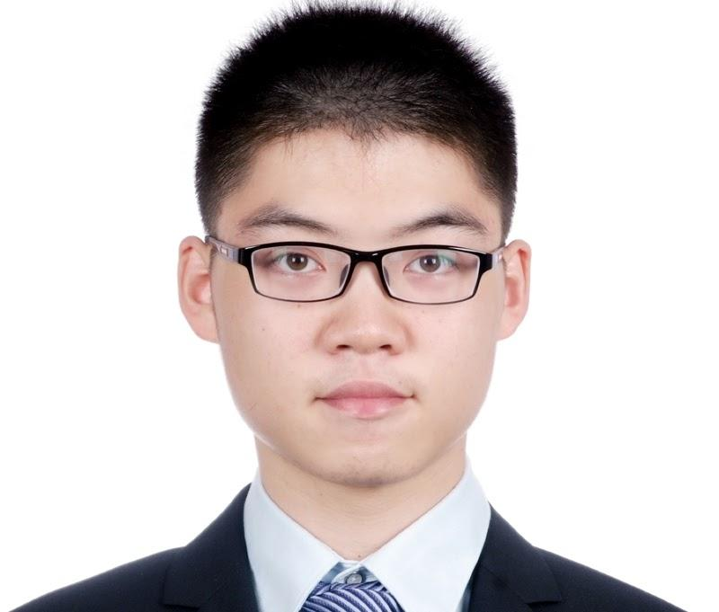
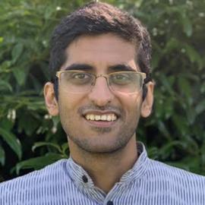


Course Office Hours
TA Office Hours
HW questions; project questions & feedback
Gautam + Deqing
Wednesdays 3-4pm
Tejas + Bingjie
Thursdays 10am-11am
Location:
RTH 4th Floor
See website/Piazza for most recent
Jesse Thomason
Deqing Fu
Gautam Salhotra
Instructor Office Hours
Mon 10am-11am
SAL 244
NOT for homework related questions.
Tejas Srinivasan
Bingjie Tang

Slide 7
Course Deliverables
Deliverable | Points of the total grade
Pop-up Quizzes | 5
Assignment #1 | 10
Assignment #2 | 10
Paper Roleplaying Breakout | 10
Midterm | 20
Course Project | 45
TOTAL | 100
Project Deliverable | Points of the project grade
Project Proposal & Teaming | 2
Project Pitch | 1
Project survey | 5
2 meetings with TA | 2
Project Mid-report | 12
Final Presentation | 8
Final Report | 15
TOTAL | 45

Slide 8
Course Project - Quick Recap
Project teaming starts now; look for people with common interests and complementary skills!
Inform the TAs via filling up the online form (one submission for each team); this form will be posted to Piazza.
For project grades, whole team receives the same grade for each of these entries.
Teams of 4 (strictly enforced)
You may not work with students outside this course.
You may not share code with other teams in the course.
You must enumerate individual contributions in reports

Slide 9
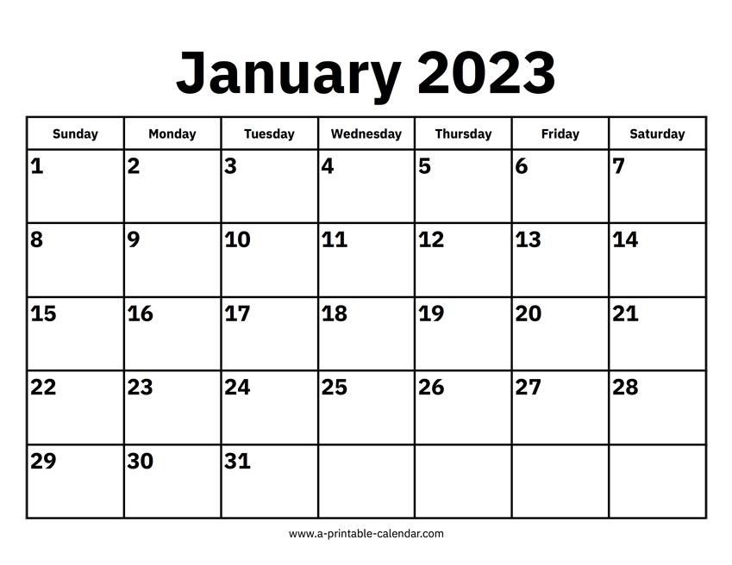
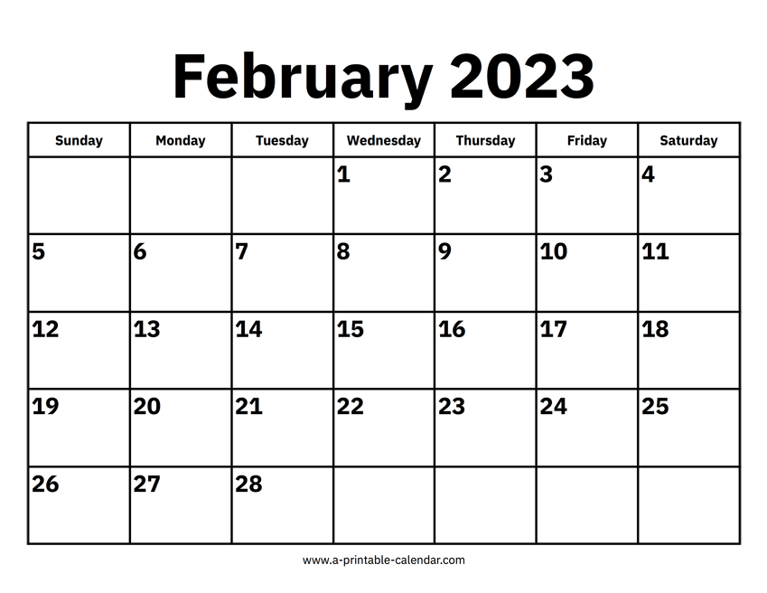

Map to the Midterm
Module 1: Neural Network Basics

Slide 10
CSCI 566 Roadmap
Module 1: Neural Network Basics
Jan 13 - Feb 24 [5 lecture days, 1 exam day, 1 free week]
Some lectures will involve tutorials from TAs
Coding Assignment 1
Module 2: Deep Learning Applications
Mar 3 - Mar 24 [3 lecture days, 1 free week]
Project lightning pitches in class
Project survey due
Coding Assignment 2

Slide 11
CSCI 566 Roadmap
Module 3: Advanced Topics in Deep Learning
Mar 31 - Apr 28 [4 lecture days, 2 presentation days]
Paper Roleplaying Breakout sessions
Project mid-term report due
Final project presentations
Final Report
Due on the final exam day, Wednesday May 3
There will be no in-class final exam
You may use Late Day Tokens for the final report

Slide 12
Welcome to CSCI 566!
For example, our enrollment just increased by 100 students.
Welcome, 100 new students!
Please look over Lecture 1 slides online!
This course is still evolving and we are trying out some new things this time.
The syllabus, course policy, and grading details may change over the semester.
It will be fun but challenging!
Our main organizing tool will be Piazza
Website: https://csci566-spring2023.github.io/
Piazza: https://piazza.com/usc/spring2023/csci566/info
That many new faces and Project Teams means we have some adjustments to our planned assignments.

Slide 13
Changes To Course Project Deliverables
Project pitches → 1 minute lightning pitches given by one representative per team
Previously these would have been longer
Final presentations → 5 minutes per team, spread over two weeks’ meeting times (i.e., two of our classes)
Previously, these would have been longer and maybe crammed into a single week’s meeting time
Paper Roleplaying Breakout Sessions [Module 3]
Replaces “Paper Presentations” given by team members

Slide 14
Due Dates and Late Day Tokens
Material is always due at 11:59pm PT on the day of the deadline; the late penalty is 5% off the total score per day after
Each student will have 5 Late Day Tokens to expend as they see fit on any non-presentation-based assignments
When you turn something in late, you must leave a note with the assignment specifying how many Late Day Tokens you wish to expend
Tokens are individual, so when using for project-related assignments they must be expended by all team members; team members who do not expend will receive the late penalty

Slide 15
Course Supplemental Readings
In most weeks there are suggested readings that will help you deep dive into lecture topics.
Textbooks:
Deep Learning (MIT Press)
Ian Goodfellow, Yoshua Bengio, and Aaron Courville
Free online version is available at http://www.deeplearningbook.org/
Neural Network Methods for Natural Language Processing
Yoav Goldberg

Slide 16
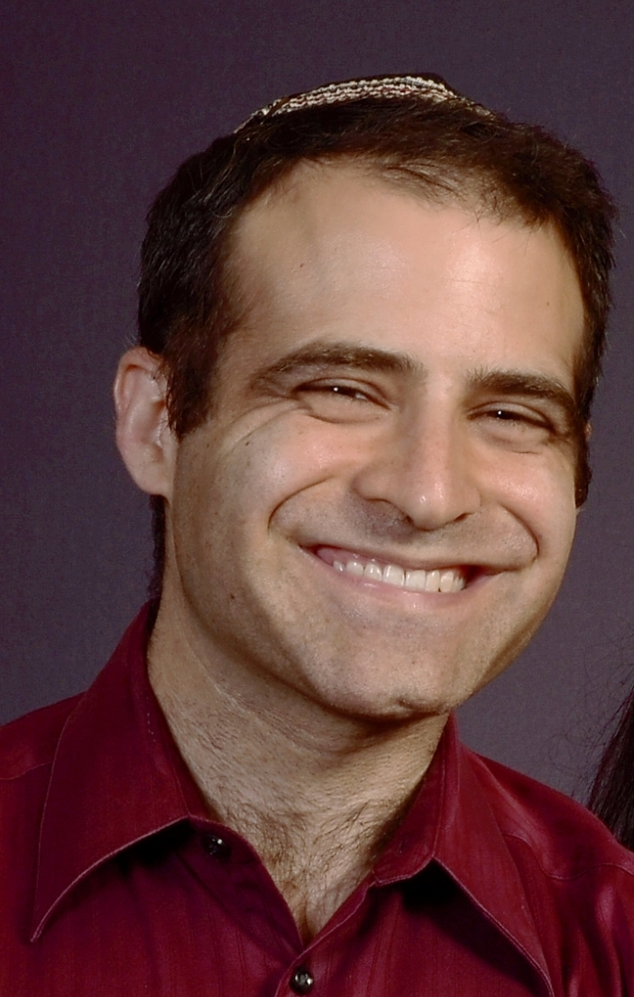
[Jan 20] A Look at January
Week 1 | Jan 13
Week 2 | Jan 20
No Class Next Week! | Jan 27
CS Invited Talk: David Held
“Robots Perceiving And Doing”
Jan 27 11am-12pm RTH 115

Slide 17
[Jan 20] A Look at February Deliverables
Project Teams Formed | Feb 3
Assignment 1 Out | Feb 10
Project Proposal Due | Feb 17
Assignment 1 Due | Feb 24
Midterm Exam | Feb 24
Two weeks to form your project teams. Feb 3 11:59pm

Slide 18
Course Project
Form 4-person teams
Select from provided project ideas
https://docs.google.com/document/d/1bQusP0uS8KoVk7ZmxpGs209gBD3N9p-aSzMTTM63k1k/
This is a living document; you can expect more projects to be added, especially when we get more TAs!! 😮
We will add this doc to Piazza resources
Or design your own project, using the project ideas doc as an outline for what you should include in your proposal slide deck

Slide 19
Course Compute
We have applied for both CARC and Google Cloud Platform credits for the course
CARC is approved!
We will have TA-led tutorials on using these resources during Module 1

Slide 20
Overview of Today’s Plan
Course organization and deliverables recap
Any questions before we move on?
Framing Problems for Machine Learning
Loss Functions and Optimization
Representations and Models

Slide 21
Framing Problems for Machine Learning
What is the relationship between Deep Learning and Machine Learning?
Deep Learning ⊂ Machine Learning
What is a reasonable working definition of Artificial Intelligence?
Computer systems whose applications are those that are normally done by humans (e.g., translation, perception)
What is the relationship between Deep Learning and AI?
AI systems utilize DL as a method to approach applications

Slide 22
Framing Problems for Machine Learning
How do we frame an AI application as a deep learning problem?
We can start by framing it as a machine learning problem, since Deep Learning ⊂ Machine Learning
What is the most general formulation of the goal of Machine Learning we can express?
Given an input x∈X, produce a desired output y∈Y, using a learned function f(x)≈y.

Slide 23
f: X ✕ Θ → Y;
f(x;θ)=y; θ∈Θ for model M
f: X → Y;
f(x)=y
f: ɸ_{x}(X) ✕ Θ → ɸ_{y}(Y);
f(x;θ)=y
f: ɸ_{x}(X) → ɸ_{y}(Y);
f(x)=y
DL enables function approximation for f and is constrained by:
Data representation ɸ
Model architecture M
Loss function L
Optimization algorithm
Training data D
θ*=min_{θ∈Θ}(Σ_{(x,y)}L(f(x;θ), y)))
θ*=min_{θ∈Θ}(Σ_{(x,y)∈D}L(f(x;θ), y)))

Slide 24
Framing Problems for Machine Learning
If you can:
Squeeze your input and output into numerical representations (e.g., vectors)
Compose neural layers that eat something shaped like the input and spit out something shaped like the output
Define a loss function and apply an optimizer that are valid in the underlying problem and model space
Then:
Your DL model will train and loss will go down, even if you aren’t actually solving the problem you wanted to solve

Slide 25
Framing Problems for Machine Learning
Different problem classes based on input and output spaces can be tackled by varying our function f(x)
Regression:
Output space y is continuous and ordered
X={Input Texts}, Y={Reading Grade Level Difficulty}
Classification:
Output space y is discrete and unordered
X={ImageNet Images}, Y={1000 ImageNet Classes}

Slide 26

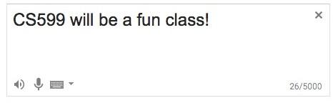
Framing Problems for Machine Learning
Input space X?
Source language tokens S
X=S^{N} for maximum translation source length N
Output space Y?
Target language tokens T
Y=T^{M} for maximum translation target length M
What are tokens? Why might N and M differ?
What might our function f(x) look like? Classification or regression?

Slide 27
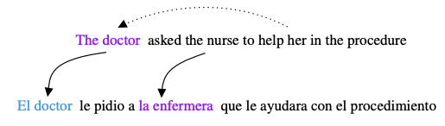

Framing Problems for Machine Learning
What might our function f(x) look like?
What went wrong when learning f(x) to enable this mistake?
Evaluating Gender Bias in Machine Translation (2019)

Slide 28
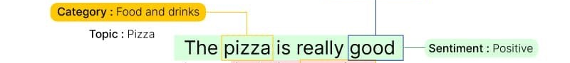
Framing Problems for Machine Learning
Input space X?
Review tokens T
X=T^{N} for maximum review length N
Output space Y?
Possible sentiments S
Y=S
What labels might you put in the set S?
What might our function f(x) look like? Classification or regression?

Slide 29
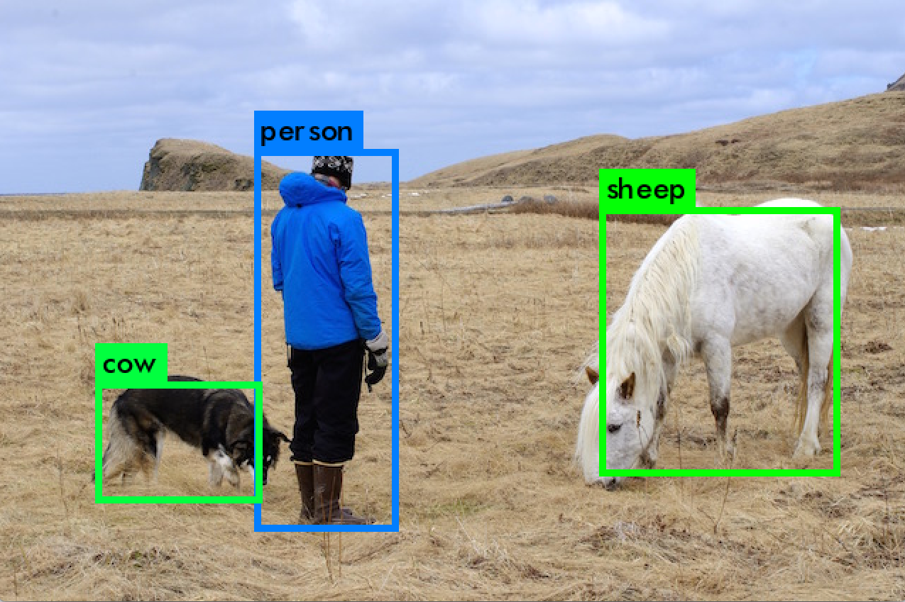
Framing Problems for Machine Learning
Input space X?
Pixels in the image
X=R^{W,H,3}
Output space Y?
Object classes C
Object bounding boxes
Y=C ✕ R^{x,y,w,h} ✕ N
What’s N in the output space?
What might our function f(x) look like? Classification or regression?

Slide 30
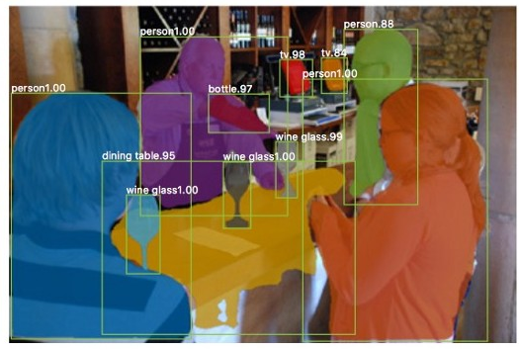
Deep Learning for Vision: Object Segmentation
Input space X?
Pixels in the image
X=R^{W,H,3}
Output space Y?
Object classes |C| per pixel in the image
Y=R^{W,H,|C|}
How else might you represent Y?
What might our function f(x) look like? Classification or regression?

Slide 31
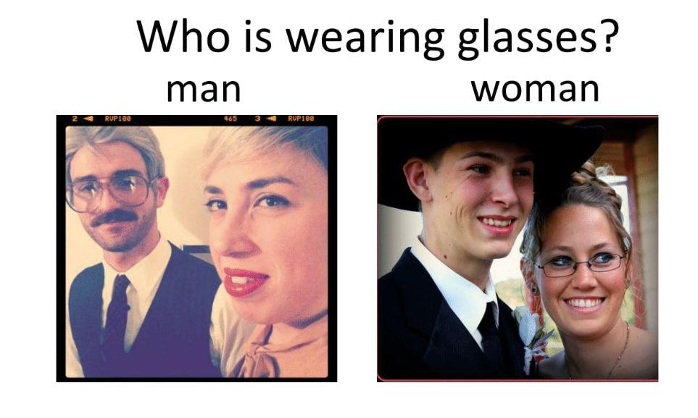
Framing Problems for Machine Learning
Input space X?
Pixels in the image
Tokens in the question
X=R^{W,H,3}✕ T^{N}
Output space Y?
Possible answers A
Y=A
How else might you represent Y?
What might our function f(x) look like? Classification or regression?

Slide 32

Framing Problems for Machine Learning
Input space X?
Tokens in the caption
X=T^{N}
Output space Y?
Pixels of an image
Y=R^{W,H,3}
What might our function f(x) look like? Classification or regression?
Why does this example feel different from the others?

Slide 33
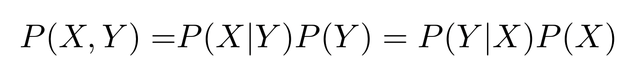
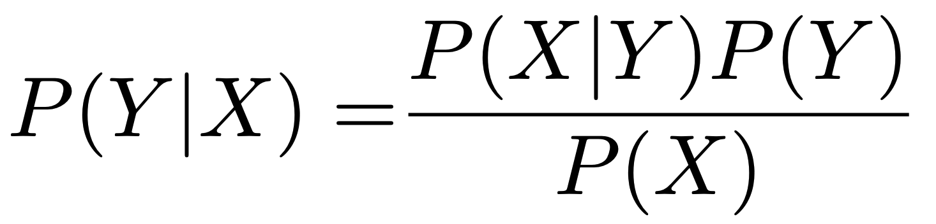
ML FUNDAMENTALS: Discriminative v. Generative
Bayes’ Rule
Likelihood of Y
Prior of Y
Posterior of Y
Discriminative Estimate P(Y|X) from data.
E.g., {f(x)=y} ↔ {p(y|x)}
Generative Estimate P(X|Y) and P(Y) from data.
E.g., {f(x)=y} ↔ {p(y) occurs and p(x|y) that y explains observed x}

Slide 34

Framing Problems for Machine Learning
Should we estimate f(x) with a discriminative or generative approach?
What went wrong in the estimation of f(x) above?

Slide 35
Framing Problems for Machine Learning
What is the most general formulation of the goal of Machine Learning we can express?
Given an input x∈X, produce a desired output y∈Y, using a learned function f(x)≈y.
How do we start deep learning?
Well, first let’s think about whether we oughta, and then see what might slow us down along the way.

Slide 36
DL FUNDAMENTALS: Start Without DL
Always look at your data! What will the model see?
Always implement a strong baseline!
Strong does not always mean “clever”
Strong never means “fancy” or “complicated”
https://twitter.com/seanjtaylor/status/1550326602105466880?s=20&t=0ZjH63z3S22vwAdG9l5D0g

Slide 37
Framing Problems for Machine Learning
What is the most general formulation of the goal of Machine Learning we can express?
Given an input x∈X, produce a desired output y∈Y, using a learned function f(x)≈y.
What’s a simple, non-degenerate learned function?
First assume we can transform input x into a vector representation, ɸ(x)=x
Then we can study a simple linear model: f(ɸ(x))=Wɸ(x)+b
Weight matrix W, bias vector b

Slide 38
Linear Classification
f(ɸ(x))=Wɸ(x)+b
f(x) = Wx+b
This is a familiar, linear function
Going back to Image Classification, the target application of the famous AlexNet, let’s see how our linear function fits into the framework we’re describing

Slide 39

Linear Image Classification
Input space X?
Pixels in the image
X=R^{50,50,3}
Output space Y?
Object classes C = {airplane, car, cat}
Y=C
f(x)=Wx+b; size of W and b? How does Wx+b give us a class C?
W maps every pixel value (50*50*3) to a posterior probability of each C

Slide 40
Linear Image Classification
W maps every pixel value (50*50*3) to a posterior probability of each C
Then our output space should be dimension |C|; we can encode Y as a one-hot vector <0, 1, 0>
To learn f(x)=Wx+b directly:
W^{<|C| x 50*50*3>}x^{<50*50*3>} + b^{<|C|>}
Input space X?
Pixels in the image
X=R^{50,50,3}
Output space Y?
Object classes C = {airplane, car, cat}
Y=C

Slide 41
Linear Image Classification
W maps every pixel value (50*50*3) to a posterior probability of each C
Then our output space should be dimension |C|; we can encode Y as a one-hot vector <0, 1, 0>
To learn f(x)=Wx+b directly:
W^{<|C| x 50*50*3>}x^{<50*50*3>} + b^{<|C|>}
That representation is really big for our slides demonstration
Let’s use our encoding function ɸ(x) to get a vector x from image input x that’s smaller
For simplicity, we’ll divide the image into quadrants and create one superpixel per quadrant that’s just the average intensity of all the pixels in it (e.g., flatten over x,y,RGB all together)

Slide 42
Linear Image Classification
Now W maps every superpixel intensity value (2*2) to a posterior probability of each C
Note: yes, this is a dumb representation; bear with it for the purposes of the linear model demonstration.
Remember our output space is now a one-hot vector <0, 0, 1, 0, 0> of length |C|
Now To learn f(x)=Wx+b directly:
f(x)=W^{<2*2 x |C|>}x^{<2*2>} + b^{<|C|>}
f(x)=W^{<3x4>}x^{<4>} + b^{<3>}
In other words, we have 4 input features that we will learn to map to 3 output classes

Slide 43
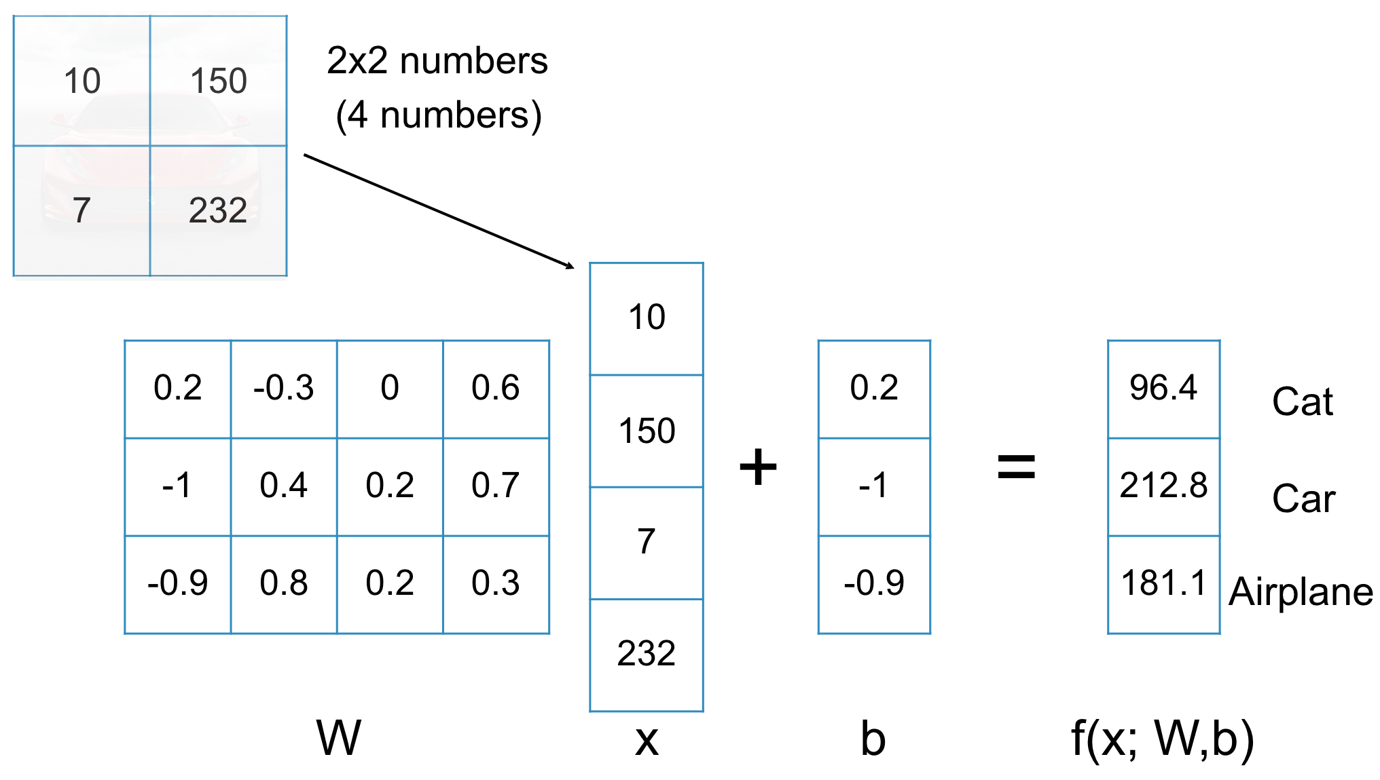
Linear Image Classification
W: how much each input feature indicates each class (e.g., p(y|x))
b: how likely each class is alone (e.g., p(y))
Great, so “Car” is the highest number. How do we get W and b though?

Slide 44
Overview of Today’s Plan
Course organization and deliverables recap
Framing Problems for Machine Learning
Any questions before we move on?
Loss Functions and Optimization
Representations and Models

Slide 45
ML FUNDAMENTALS: Neural Network Training
A neural network is, commonly, a composition of matrix multiplications and non-linear transformations
A neural network can perform non-linear function approximation through repeated linear layers and non-linear transformations
Optimization: M(ɸ(x), θ) = y for pairs (x, y) in data by making adjustments to θ
Optimizers in modern NN packages are variations on the basics: Stochastic Gradient Descent

Slide 46
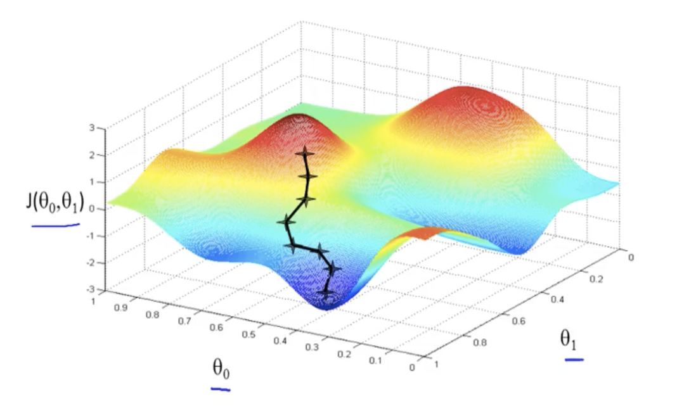
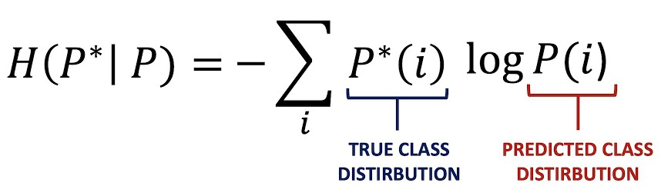
ML FUNDAMENTALS: Stochastic Gradient Descent
Gradient Descent
“Step” ε∇ L[M(ɸ(x), θ)]
Go a little bit in the direction of the gradient (derivative) towards a local minima in the loss
“Loss”: measure of how poorly the model did, e.g., the cross-entropy between predicted and true classes

Slide 47
ML FUNDAMENTALS: Stochastic Gradient Descent
“Step” ε∇ L[M(ɸ(x), θ)]
What’s ε?
Learning rate
Can we actually get ∇ over all of D?
Sometimes! Usually “no”, and so we use stochastic GD
Could estimate ∇_{x} with a single sample (x,y). Why not?
Could estimate ∇_{xi…xj} with, e.g., as many examples as we can fit in RAM at a time x_{i}…x_{j}. What do we call these?
Each subset of D used to estimate gradient is a mini-batch

Slide 48
ML FUNDAMENTALS: Stochastic Gradient Descent
“Step” ε∇_{xi…xj} L[M(ɸ(x), θ)]
Learning rate: ε
Mini-batch: (x,y)_{i}…(x,y)_{j}
Iteration: θ := θ - ε∇_{xi…xj} L[M(ɸ(x), θ)]
Move parameters in direction of gradient estimated for a mini-batch
Epoch: Completed each time we’ve seen all of (x,y)∊D again

Slide 49
ML FUNDAMENTALS: Neural Network Training
Optimizers in modern NN packages are variations on the basics: Stochastic Gradient Descent
What do we need?
Pass over data for multiple epochs
Sample mini-batches of our data
Step the optimization algorithm to complete an iteration
Let’s step through a motivating example to see how we arrive at training deep neural networks for function approximation

Slide 50


Linear Image Classification

Slide 51
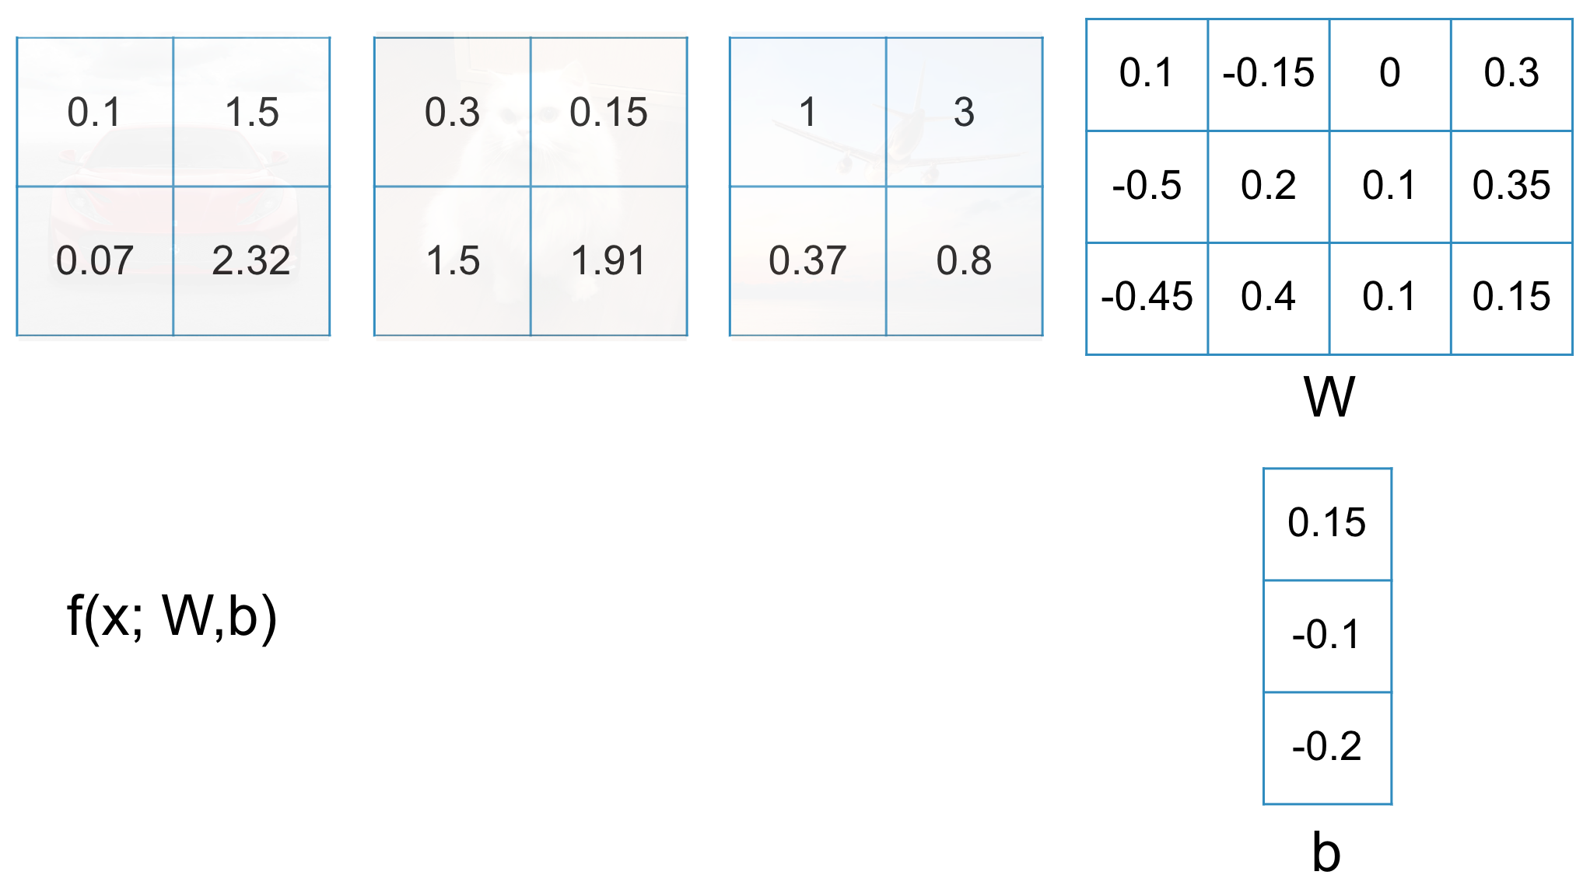
Linear Image Classification
What does a good f(x; W,b) look like?

Slide 52
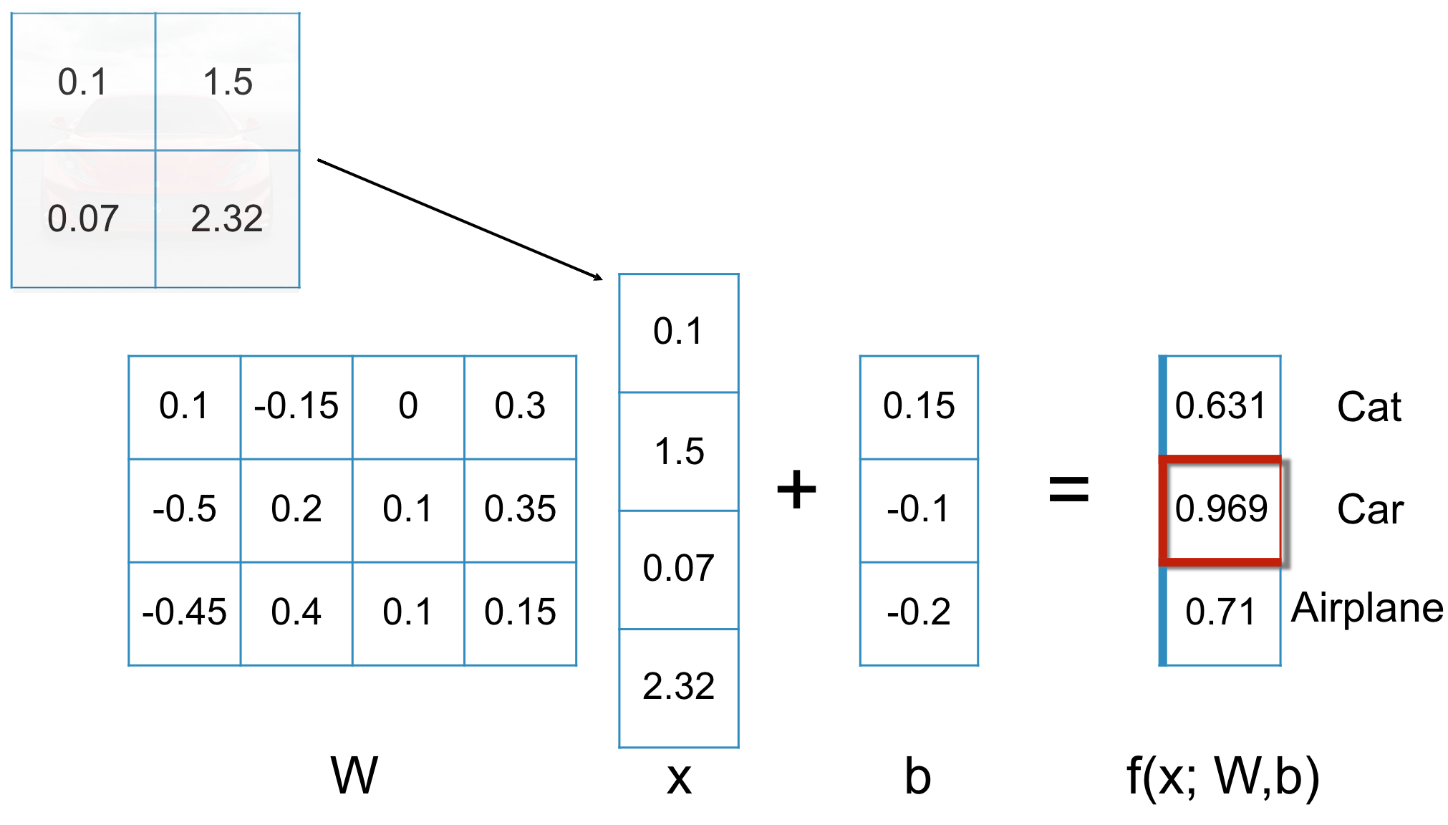
Linear Image Classification
What does a good f(x; W,b) look like?

Slide 53
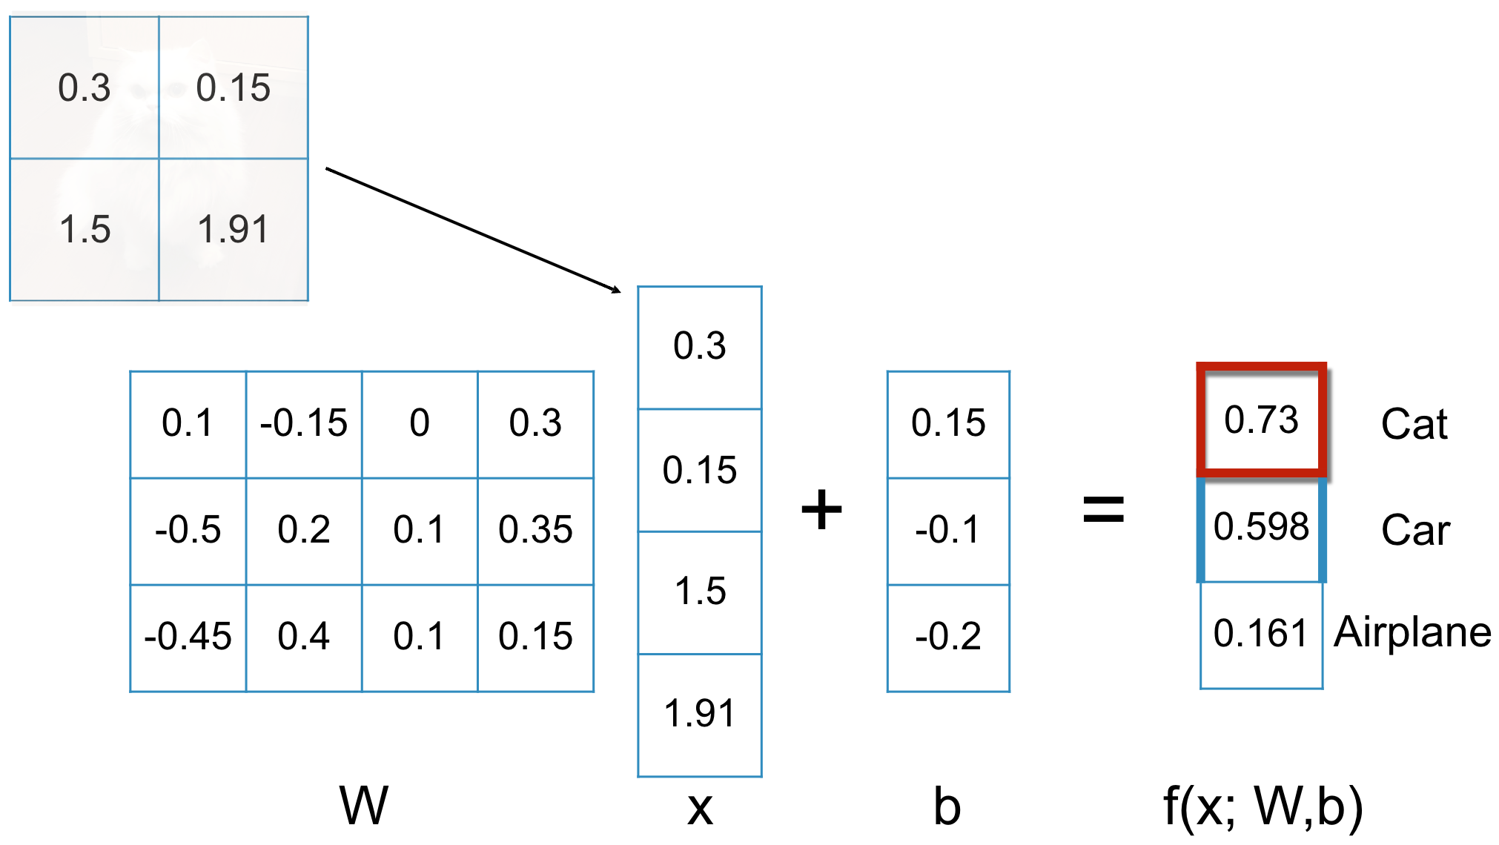
Linear Image Classification
What does a good f(x; W,b) look like?

Slide 54
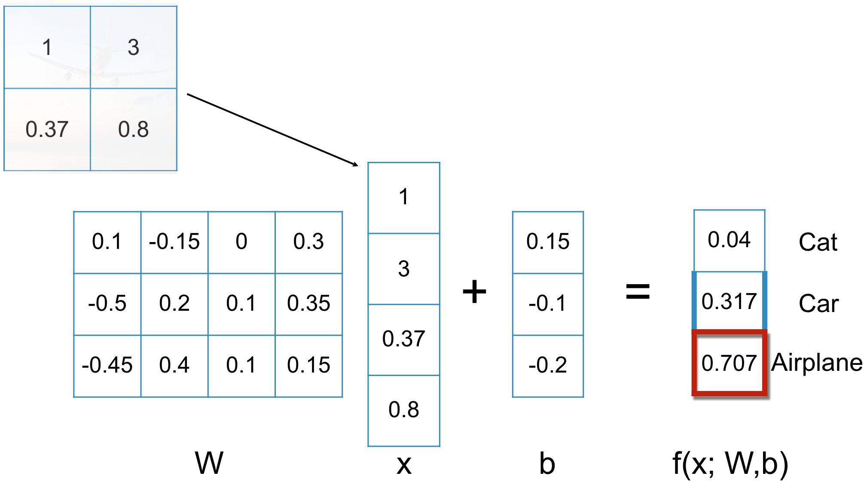
Linear Image Classification
What does a good f(x; W,b) look like?

Slide 55
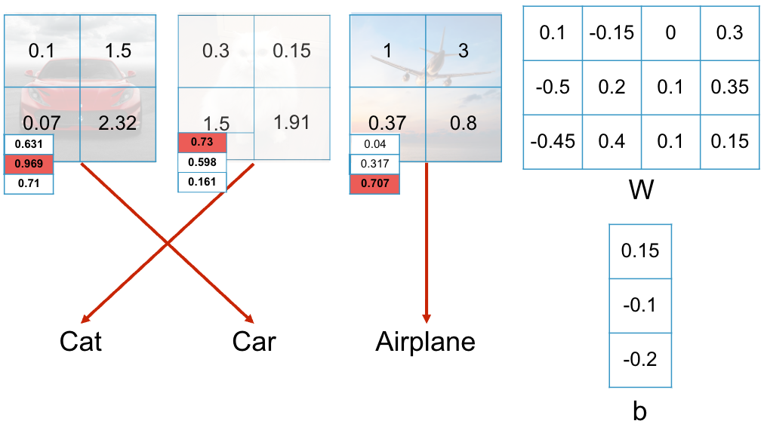
Linear Image Classification
What does a good f(x; W,b) look like?
This f(x; W,b) seems good for these three!

Slide 56
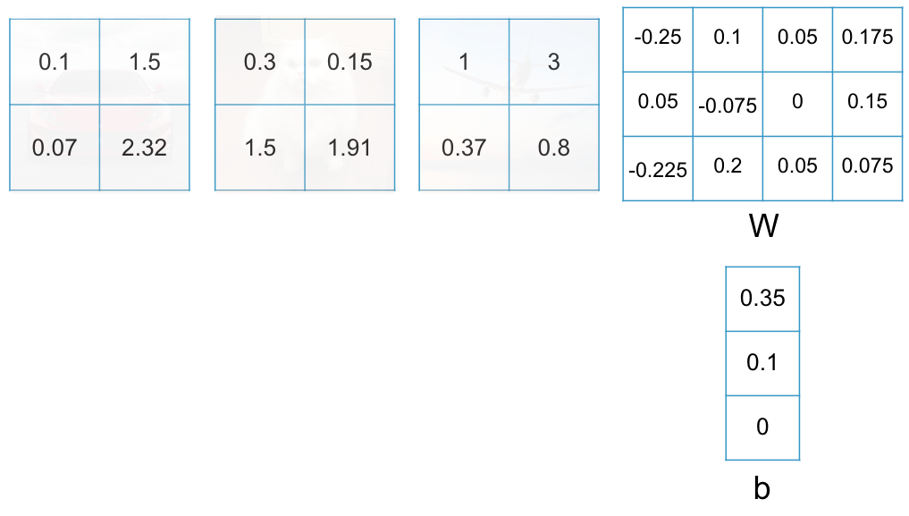
Linear Image Classification
Same images, new candidate weights W and bias vector b
Let’s check our predictions for these…

Slide 57
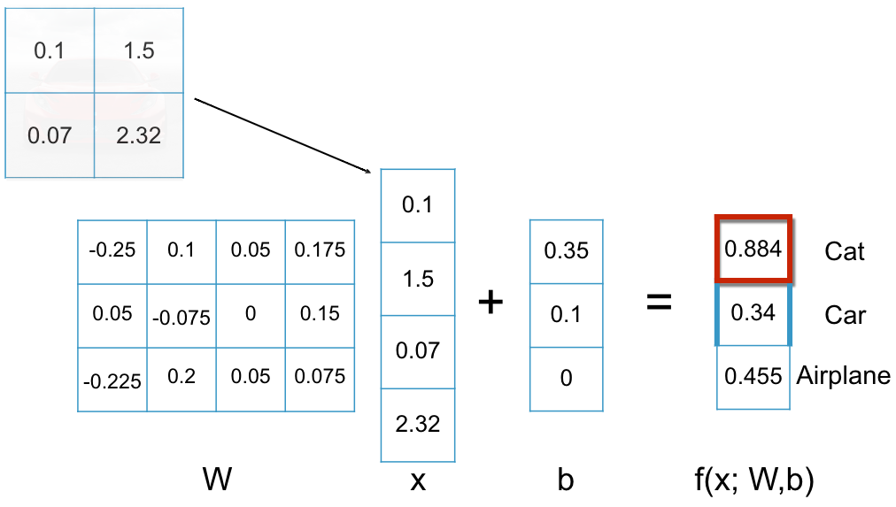
Linear Image Classification
Same images, new candidate weights W and bias vector b

Slide 58
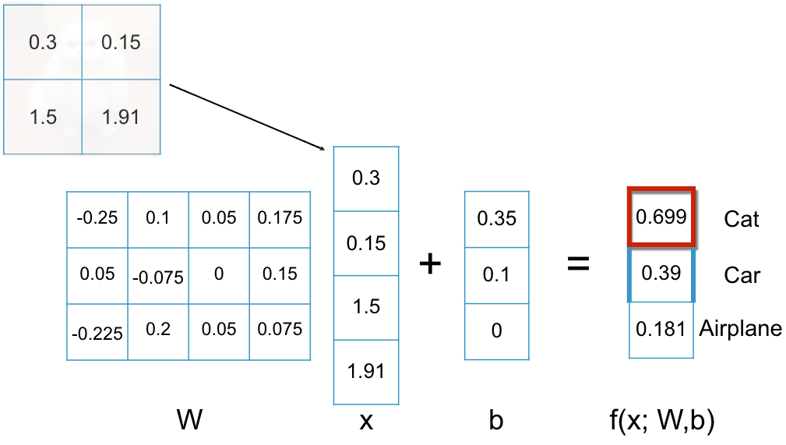
Linear Image Classification
Same images, new candidate weights W and bias vector b

Slide 59
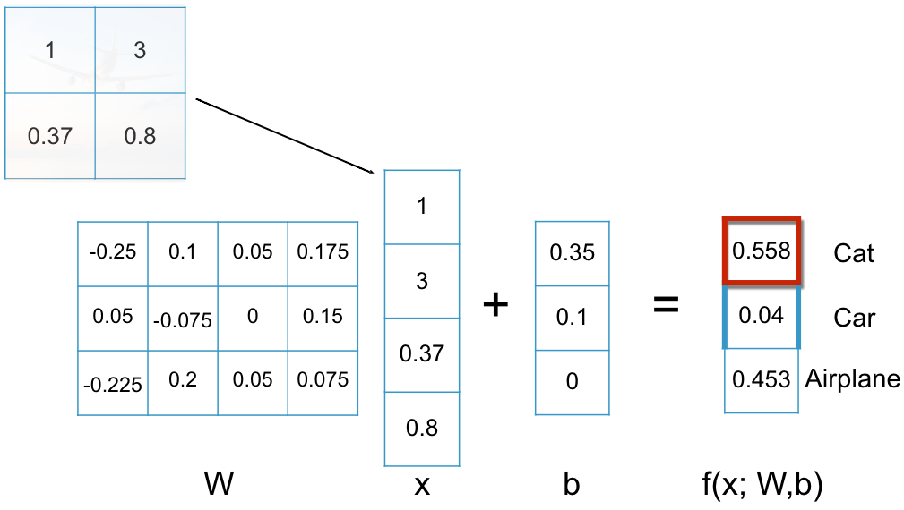
Linear Image Classification
Same images, new candidate weights W and bias vector b

Slide 60
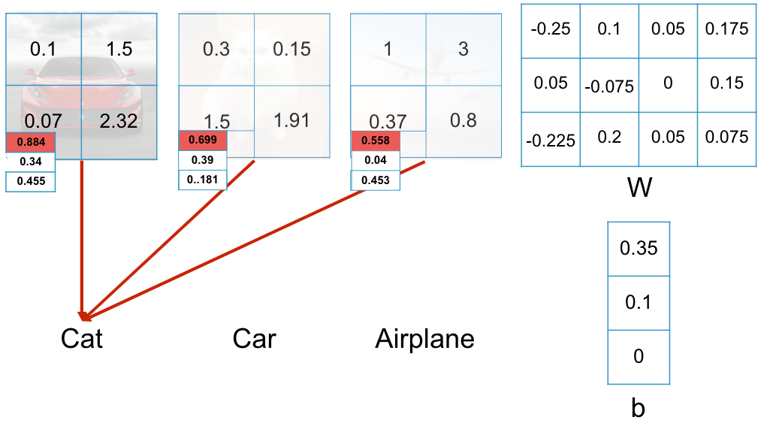
Linear Image Classification
Same images, new candidate weights W and bias vector b
This f(x; W,b) is pretty bad!

Slide 61
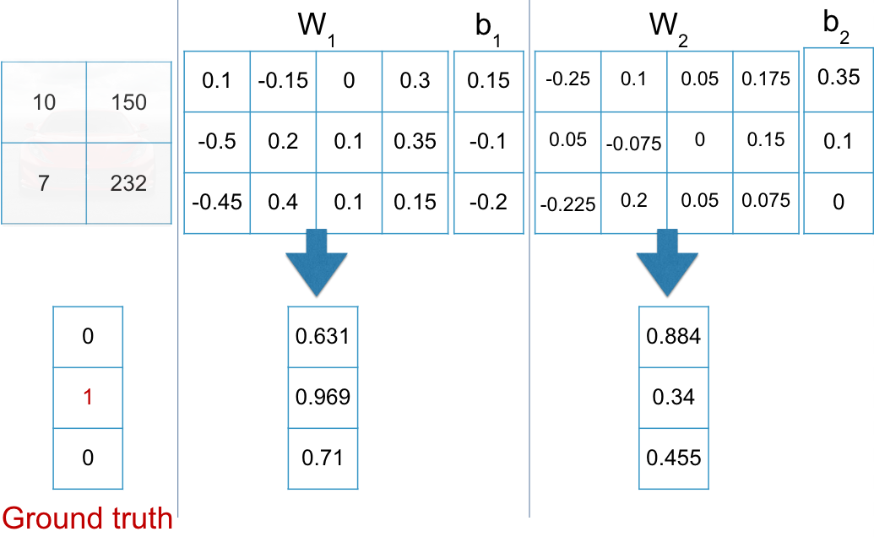
Linear Image Classification
How do we measure the fit of candidate parameters?

Slide 62
How Do We Measure the Quality of f(x;θ) ?
How do we measure the fit of candidate parameters?
Target vector f*(x) if we knew the exact function, f*:
<0.00, 1.00, 0.00>
Prediction of f(x;θ₁):
<0.63, 0.97, 0.71>
Prediction of f(x;θ₂):
<0.88, 0.34, 0.46>
We want a way to penalize distance between f*(x) and predicted vectors
x
θ₁
θ₂
f*(x)
f(x;θ₁)
f(x;θ₂)

Slide 63
How Do We Measure the Quality of f(x;θ) ?
How do we measure the fit of candidate parameters?
Want to formulate an optimization problem to minimize the distance {f*(x) - f(x;θ)} across all x_{i}∈X in a dataset of (X, Y) pairs
We call the function we want to minimize, subject to the available training data, the loss function
What are some possible ways to measure such a distance penalty? We want “good” θ to have less loss than “bad” θ

Slide 64
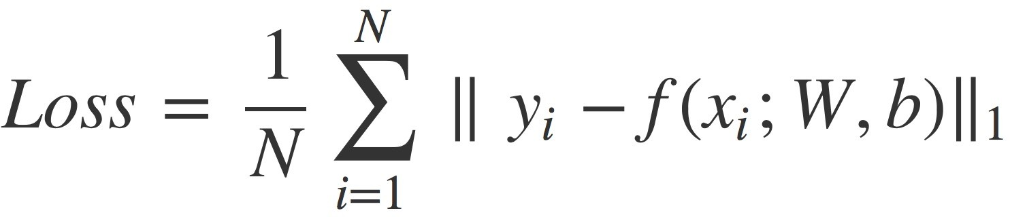
How Do We Measure the Quality of f(x;θ) ?
We could just sum up all the distances over the dataset!
This loss function is called L₁ Loss
What could go wrong?
If many examples are right, some can be egregiously wrong and the loss will be linearly bounded by those wrong examples only; model could learn to ignore hard pairs

Slide 65
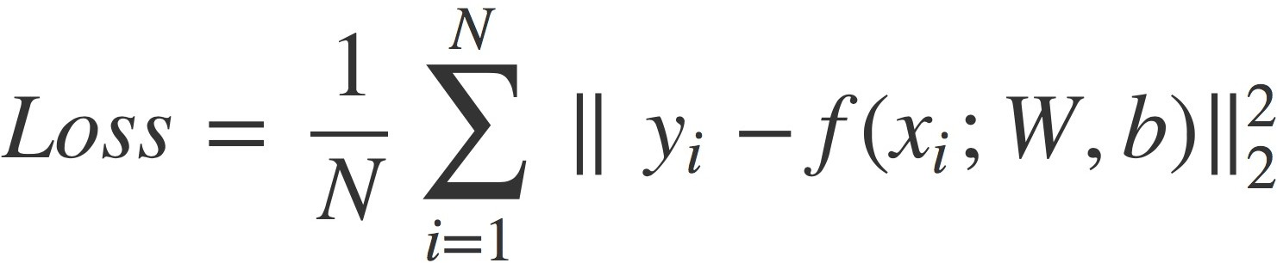
How Do We Measure the Quality of f(x;θ) ?
We could add a quadratic penalty
This loss function is called L₂ Loss
What could go wrong?
The model doesn’t have a strong incentive to get f “exactly” right; for terms less than 1 the square makes them less severe

Slide 66
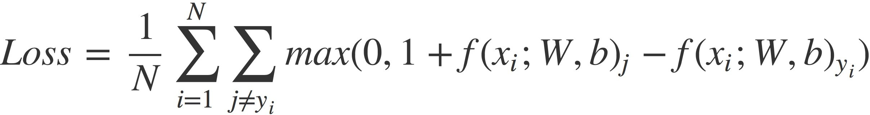
How Do We Measure the Quality of f(x;θ) ?
We could individually discourage misclassifications
This loss function is called Hinge Loss
For every example x_{i}, the loss is non-zero if f(x_{i};θ) assigns a score to a wrong class that is within a hinge level of the score assigned to the true class y_{i} (here, the hinge penalty is 1)

Slide 67
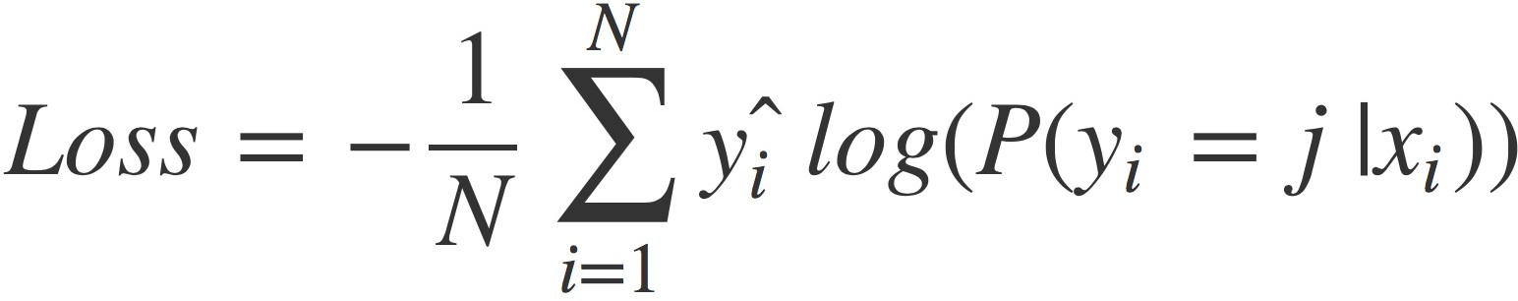
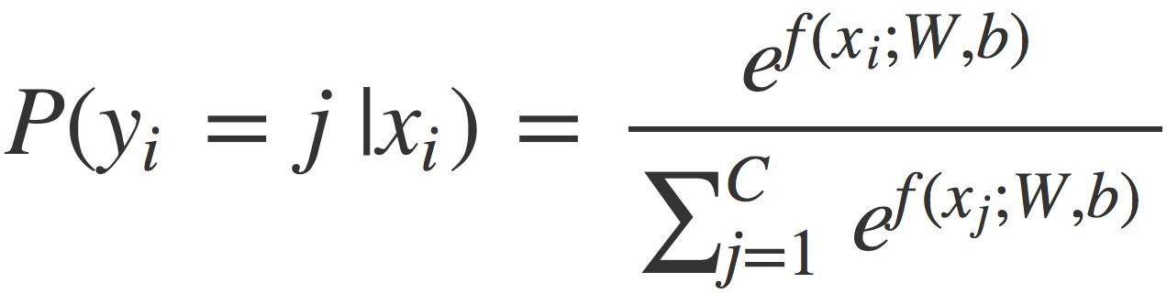
How Do We Measure the Quality of f(x;θ) ?
We could turn our scores into a probability distribution
This loss function is called Cross-Entropy Loss
For every example x_{i}, the loss approaches zero as the score for true class y_{i} dominates the sum of all scores, and approaches infinity (slowly!) as score y_{i} is dominated by other class scores

Slide 68
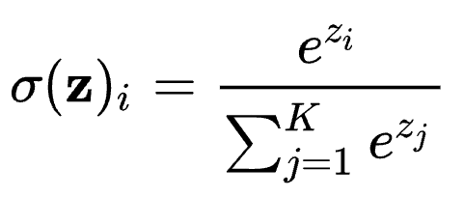
ML FUNDAMENTALS: Softmax Function
Sometimes we want a probability distribution over possible outputs from our model
We can induce a probability distribution from a set of output logits (“activations” / “energies” / “scores”)
For z_{i} the logit of class i in the prediction space, the softmax probability is given by:
p(y_{i})
z_{i}=x_{i}W+b
𝜎(xW + b)
x
https://en.wikipedia.org/wiki/Softmax_function

Slide 69
How Do We Measure the Quality of f(x;θ) ?
How do we measure the fit of candidate parameters?
Want to formulate an optimization problem to minimize the distance {f*(x) - f(x;θ)} across all x_{i}∈X in a dataset of (X, Y) pairs
We call the function we want to minimize, subject to the available training data, the loss function
Which loss function should you use?
It depends!!
Loss is a core component of problem formulation
Input/output representation, model, loss function, optimization method

Slide 70
How Do We Measure the Quality of f(x;θ) ?
How do we measure the fit of candidate parameters?
We can calculate the loss of parameter options θ₁ versus θ₂ across a dataset (X, Y)
Now that we can measure the quality of a set of parameters, we can consider how to discover those parameters
x
θ₁
θ₂
f*(x)
f(x;θ₁)
f(x;θ₂)

Slide 71
How Do We Find Good Parameters θ for f(x;θ) ?
Backing up:
f(x;θ) is our notation for any general function we’d like to learn
f(x;θ) maps from x∈X to y∈Y
Vector x is obtained by applying representation function ɸ(x)=x to input
θ parameterizes f; f is a class of functions that can vary according to the selection of θ
For example, θ={W,b} for f(x;θ)=Wx+b

Slide 72
How Do We Find Good Parameters θ for f(x;θ) ?
f(x;θ)=Wx+b; θ={W,b}
In our running image classification example, how do we define what are good parameters?
We pick a loss function L!
θ*=min_{θ∈Θ}(L(f(x;θ), y))
L is calculated on an (x, y) basis, so we really want to find good parameters for an entire dataset, not just one example!
θ*=min_{θ∈Θ}(Σ_{(x,y)∈D}L(f(x;θ), y)))
For D={(x₁,y₁), (x₂,y₂), …, (x_{n},y_{n})} our training dataset

Slide 73
How Do We Find Good Parameters θ for f(x;θ) ?
f(x;θ)=Wx+b; θ={W,b}
θ*=min_{θ∈Θ}(Σ_{(x,y)∈D}L(f(x;θ), y)))
For D={(x₁,y₁), (x₂,y₂), …, (x_{n},y_{n})} our training dataset
Three basic classes of approach:
Analytical solution
Find where ^{d}/_{dθ} (Σ_{(x,y)∈D}L(f(x;θ), y))) = 0
Heuristic search
Initialize random candidate θ’s and check L value
Numerical approach
Estimate better θ’s given current ones

Slide 74
How Do We Find Good Parameters θ for f(x;θ) ?
f(x;θ)=Wx+b; θ={W,b}
θ*=min_{θ∈Θ}(Σ_{(x,y)∈D}L(f(x;θ), y)))
For D={(x₁,y₁), (x₂,y₂), …, (x_{n},y_{n})} our training dataset
Numerical approach
Estimate better θ’s given current ones
Best of both worlds: cheap (heuristic) + informed (analytical)
Finding where ^{d}/_{dθ} (Σ_{(x,y)∈D}L(f(x;θ), y))) = 0 is hard
Finding good θ through random/population search is hard
Calculating ^{d}/_{dθi} (Σ_{(x,y)∈D}L(f(x;θ), y))) for dimension θ_{i} is easy…

Slide 75
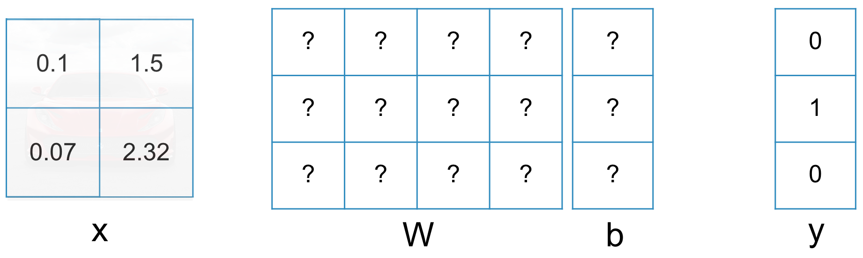
Gradient Descent
We want θ minimizing Σ_{(x,y)∈D}L(f(x;θ), y))
Calculating ^{d}/_{dθi} (Σ_{(x,y)∈D}L(f(x;θ), y))) for dimension θ_{i} is easy
For a candidate θ, we can calculate the gradient in each dimension of θ_{i} that could lead us towards the minimum

Slide 76
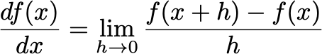
Gradient Descent
Let’s consider just W∈θ for the above (x,y) datum
Recall the definition of a derivative for a generic function f

Slide 77
Gradient Descent
We will take the derivative of L(f(x;θ), y) with respect to each individual dimension of θ
That vector of partial derivatives is called the gradient wrt (x,y)

Slide 78
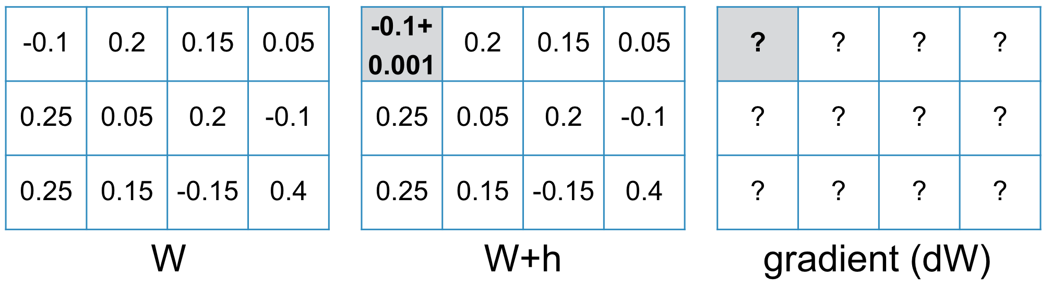
Gradient Descent
For L(f(x;θ₁), y), we calculate L before and after adding a tiny perturbation h to θ₁, giving f(x+h) verus original f(x)
(Remember, here f is our loss L and derivative is against θ₁)

Slide 79
Gradient Descent
L(W) = 1.6688
L(W+h) = 1.6693
dW₁=(1.6693 - 1.6688) / 0.001
= 0.5

Slide 80
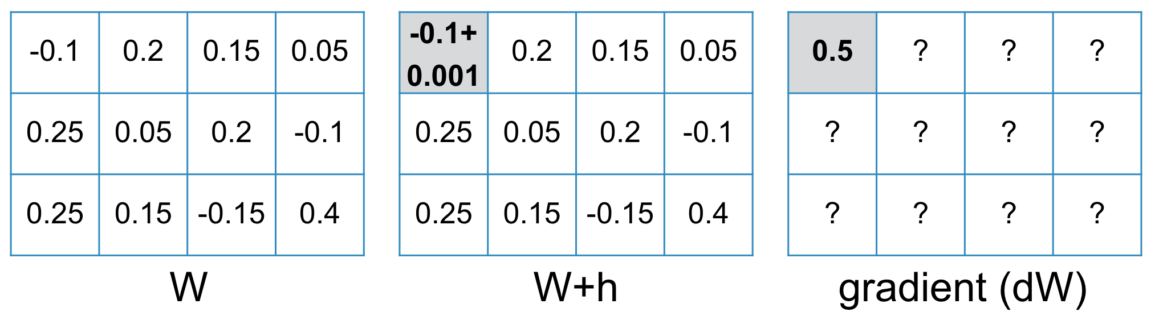
Gradient Descent
L(W) = 1.6688
L(W+h) = 1.6693
dW₁=(1.6693 - 1.6688) / 0.001
= 0.5

Slide 81
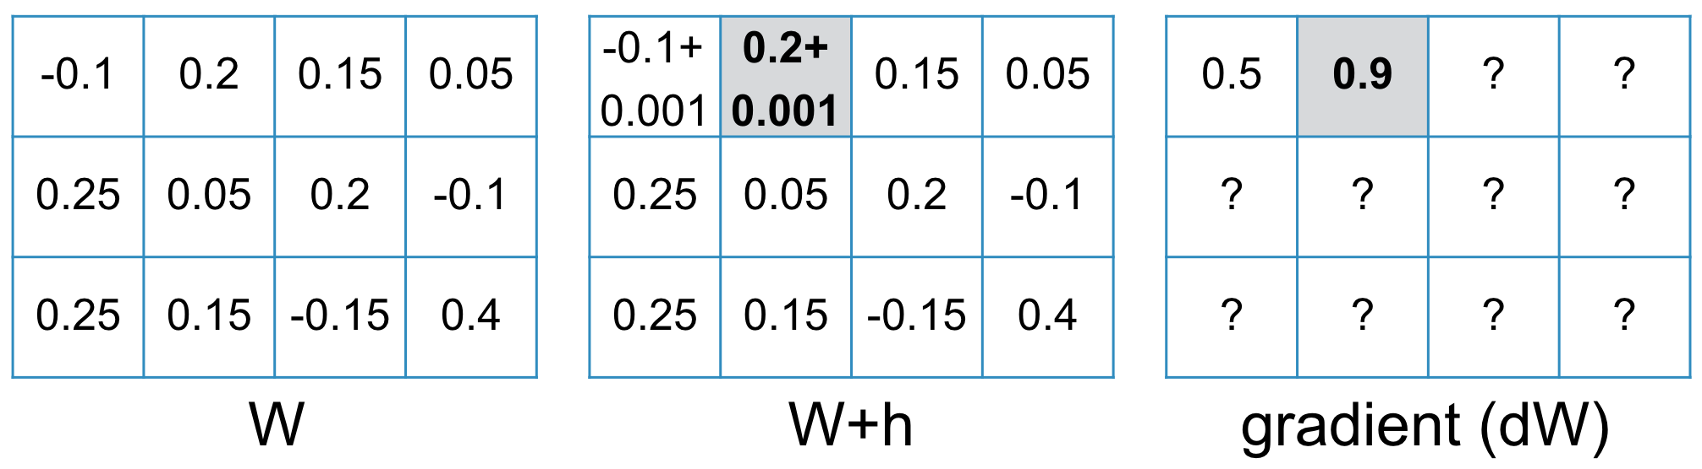
Gradient Descent
L(W) = 1.6688
L(W+h) = 1.6697
dW₂=(1.6697 - 1.6688) / 0.001
= 0.9

Slide 82
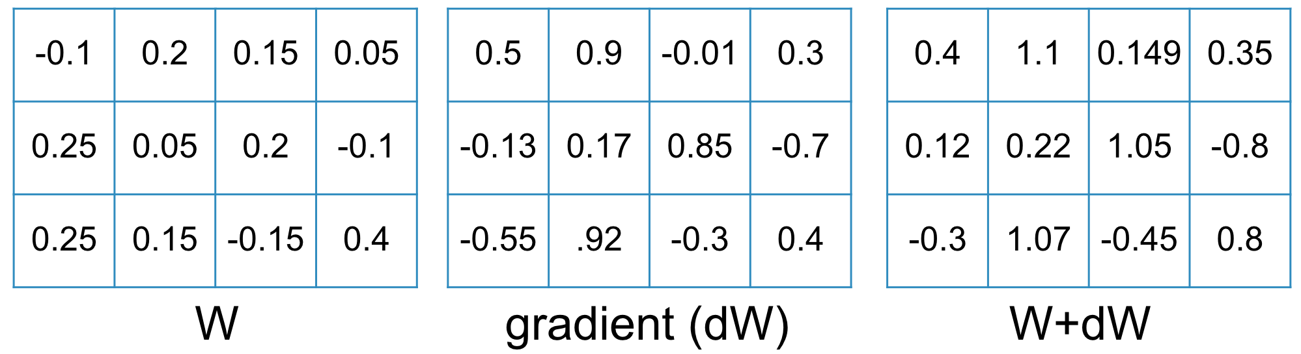
Gradient Descent
Gradient update step: add estimated gradient to existing parameters to take a “step” towards parameter values that are closer to minimizing the objective function
What’s missing?
Notes:
TODO notes: Should illustrate W - dW, not W + dW

Slide 83
Gradient Descent
f(x;θ)=Wx+b; θ={W,b}
θ*=min_{θ∈Θ}(Σ_{(x,y)∈D}L(f(x;θ), y)))
In our example, we calculated the gradient with respect to just one (x,y) pair; ∇_{(x,y)}
We actually want the gradient for Σ_{(x,y)∈D}L(f(x;θ), y)), which requires repeating our process for every (x,y)∈D
∇_{D}=(1/|D|)Σ_{(x,y)∈D}∇_{(x,y)}
What’s the problem?

Slide 84
Stochastic Gradient Descent
Storing ∇_{D}=(1/|D|)Σ_{(x,y)∈D}∇_{(x,y)} is expensive
Depending on the size of your dataset D, it’s likely not possible to store the partial derivatives for every (x,y) for every parameter in your entire model in the GPU at once
In stochastic gradient descent, we take just a slice (batch) of D at a time; in practice, as much as we can fit on the GPU
What sounds best?
Randomly sample batch from D and repeat
Shuffle D, sample slices as batches, repeat
Shuffle D, sample slices as batches, reshuffle D and repeat
Notes:
TODO notes: use parentheses to scope “repeat” clauses to avoid syntactic ambiguity in verbal algorithms

Slide 85
Where Does Deep Learning Come In?
Input space X?
Review tokens T
X=T^{N} for max length N
Output space Y?
Possible sentiments S
Y=S
Linear function: f(x,θ)=Wx+b
What loss function could we use for this n-ary classification problem?
Cross entropy
Non-linear transformation:

Slide 86
Where Does Deep Learning Come In?
Linear function: f(x,θ)=Wx+b
What loss function could we use for this n-ary classification problem?
Cross entropy
Non-linear transformation:
Our function can only capture the degree to which each dimension of the input, x_{i}, contributes to the likelihood of each class y_{j}
“... brought out the ice cold food.”
“... brought out the ice cold gazpacho.”
“... Amazing service all around. Yeah right! 🙃”

Slide 87
Where Does Deep Learning Come In?
Quick terminology note, these basic transformations are called perceptron layers / fully-connected layers
f(x,θ)=𝝈(Wx+b)
Linear function with non-linear, sigmoid activation
If we need to make decisions considering interplay between multiple x_{i} input features, what can we change in our function?
f(x,θ)=𝝈(W₂(𝝈(W₁x+b₁))+b₂)
First layer latent variables 𝝈(W₁x+b₁)) are each activated by linear combination of values of x_{i} input variables
Now W₂,b₂ can mix signals from the first layer; the final outputs 𝝈(W₂(𝝈(W₁x+b₁))+b₂) are each activated by linear combinations of the latent variables from layer one
So our class logits can now consider combinations of input words like “cold gazpacho” and “Amazing … Yeah right!”

Slide 88
Where Does Deep Learning Come In?
f(x,θ)=𝝈(W₂(𝝈(W₁x+b₁))+b₂)
This derivative is more computationally intense to take, since we need it with respect to every parameter in both weight matrices and bias vectors
Modern DL software handles these computations automatically through autograd software for efficient derivative estimation
So what’s stopping us from….
f(x,θ)=𝝈(W₄(𝝈(W₃𝝈(W₂(𝝈(W₁x+b₁))+b₂)+b₃))+b₄)
f(x,θ)=𝝈(W₈(𝝈(W₇𝝈(W₆(𝝈(W₅𝝈(W₄(𝝈(W₃𝝈(W₂(𝝈(W₁x+b₁))+b₂)+b₃))+b₄)+b₅))+b₆)+b₇))+b₈)
Nothing!?
Well, realistically, our GPU memory and data constraints
For fixed D, quality of estimated parameters θ as |θ| grows?

Slide 89
ML FUNDAMENTALS: Neural Network Training
A neural network is, commonly, a composition of matrix multiplications and non-linear transformations
A neural network can perform non-linear function approximation through repeated linear layers and non-linear transformations
Optimization: M(ɸ(x), θ) = y for pairs (x, y) in data by making adjustments to θ
Optimizers in modern NN packages are variations on the basics: Stochastic Gradient Descent
Notes:
TODO notes: these four felt redundant in the moment; the material is close enough together we probably don’t need them next time, or could limit to just one summary over the four.

Slide 90
ML FUNDAMENTALS: Stochastic Gradient Descent
Gradient Descent
“Step” ε∇ L[M(ɸ(x), θ)]
Go a little bit in the direction of the gradient (derivative) towards a local minima in the loss
“Loss”: measure of how poorly the model did, e.g., the cross-entropy between predicted and true classes

Slide 91
ML FUNDAMENTALS: Stochastic Gradient Descent
“Step” ε∇ L[M(ɸ(x), θ)]
What’s ε?
Learning rate
Can we actually get ∇ over all of D?
Sometimes! Usually “no”, and so we use stochastic GD
Could estimate ∇_{x} with a single sample (x,y). Why not?
Could estimate ∇_{xi…xj} with, e.g., as many examples as we can fit in RAM at a time x_{i}…x_{j}. What do we call these?
Each subset of D used to estimate gradient is a mini-batch

Slide 92
ML FUNDAMENTALS: Stochastic Gradient Descent
“Step” ε∇_{xi…xj} L[M(ɸ(x), θ)]
Learning rate: ε
Mini-batch: (x,y)_{i}…(x,y)_{j}
Iteration: θ := θ - ε∇_{xi…xj} L[M(ɸ(x), θ)]
Move parameters in direction of gradient estimated for a mini-batch
Epoch: Completed each time we’ve seen all of (x,y)∊D again

Slide 93
ML FUNDAMENTALS: Neural Network Training
Optimizers in modern NN packages are variations on the basics: Stochastic Gradient Descent
What do we need?
Pass over data for multiple epochs
Sample mini-batches of our data
Step the optimization algorithm to complete an iteration
Let’s step through a motivating example to see how we arrive at training deep neural networks for function approximation

Slide 94
Overview of Today’s Plan
Course organization and deliverables recap
Framing Problems for Machine Learning
Loss Functions and Optimization
Any questions before we move on?
Representations and Models

Slide 95
Representations and Models
Input space X?
Review tokens T
X=T^{N} for max length N
Output space Y?
Possible sentiments S
Y=S
Each x∊X is a sequence of tokens that together form the entire review
For example:
x=<The, pizza, is, really, good>
We can’t feed that sequence/list into equation Wx+b
We need a vector representation of x, ɸ(x)=x
The final consideration to frame problems for DL is representation ɸ

Slide 96
Vector Representations for Language - Tokenization
“A tropical bird perches in the jungle.”
+ Easy
- Sparse
|V|=|W| 💀
UNK!
Word-level
A
tropical
bird
perches
in
the
jungle
.
+ Less sparse
- Lossy (POS)
|V|=c|W| 💀
UNK!
Stemming
A
tropic
bird
perch
in
the
jungl
.
BPE
+ Denser
- Lossy
- Inconsistent
|V|=k
UNK possible
A
tropic
##al
bird
per
##ch
##es
in
the
jung
##le
.
+ Super dense
+ Consistent
- Onus on model
|V|=k
UNK preventable
Character
A
t
r
o
p
i
c
a
l
b
i
r
d
p
e
r
c
h
e
s
…

Slide 97
Vector Representations for Language
But, again, we can’t feed x=<The, pizza, is, really, good> into a model; we need to represent each individual token as a vector
What are some options we have?
Bag of words vectors: take the top K most common words and count how frequently they happen near word w; the vector is <K> occurrence averages across a corpus
Learned word embedding: initialize d-dimensional vector for each word w randomly and use backpropagation during task training to fine-tune those layers as well.

Slide 98
Representations and Models
The nature of the input, output, and intuitive relation between them gives us a lot of information as DL practitioners about what kind of model we should use
What kind of model might you use for language inputs?
Perceptron? Why or why not?
Recurrent models (RNN, LSTM, GRU)? Why?
Transformers? Why?
What kind of model might you use for vision inputs?
Perceptron? Why or why not?
Convolutional models (CNN, ResNets)? Why?

Slide 99
Representations and Models
Input space X?
Review tokens T
X=T^{N}
Representation?
ɸ_{x}(X) word embeddings
Output space Y?
Possible sentiments S
Y=S
Representation?
ɸ_{y}(Y) = one-hot vectors of length |S|
What model architecture might you use?
What loss function would you want to optimize?

Slide 100
Representations and Models
Input space X?
Pixels in the image
Representation?
ɸ_{x}(X)=R^{W,H,3} RGB or HSV
Output space Y?
Object classes C + bboxes
Representation?
ɸ_{y}(Y) = C ✕ R^{x,y,w,h} ✕ N
What model architecture might you use?
What loss function would you want to optimize?

Slide 101
Representations and Models
Input space X?
Pixels in the image
Representation?
ɸ_{x}(X)=R^{W,H,3} RGB or HSV
Output space Y?
Object classes |C| per pixel in the image
Representation?
ɸ_{y}(Y) = R^{W,H,|C|}
What model architecture might you use?
What loss function would you want to optimize?

Slide 102
Representations and Models
Input space X?
Pixels in the image
Tokens in the question
Representation?
ɸ_{x}(X)=R^{W,H,3} ✕ V^{N}
(V: word embedding space)
Output space Y?
Possible answers Y=A
Representation?
ɸ_{y}(Y) = one-hot vectors of size |A|
What model architecture might you use?
What loss function would you want to optimize?

Slide 103
Representations and Models
Input space X?
Tokens in the caption
Representation?
ɸ_{x}(X) word embeddings
Output space Y?
Pixels of an image
Representation?
ɸ_{y}(Y) = R^{W,H,3}
What model architecture might you use?
What loss function would you want to optimize?

Slide 104
f: X ✕ Θ → Y;
f(x;θ)=y; θ∈Θ for model M
f: X → Y;
f(x)=y
f: ɸ_{x}(X) ✕ Θ → ɸ_{y}(Y);
f(x;θ)=y
f: ɸ_{x}(X) → ɸ_{y}(Y);
f(x)=y
DL enables function approximation for f and is constrained by:
Data representation ɸ
Model architecture M
Loss function L
Optimization algorithm
Training data D
θ*=min_{θ∈Θ}(Σ_{(x,y)}L(f(x;θ), y)))
θ*=min_{θ∈Θ}(Σ_{(x,y)∈D}L(f(x;θ), y)))

Slide 105
Framing Problems for Machine Learning
If you can:
Squeeze your input and output into numerical representations (e.g., vectors)
Compose neural layers that eat something shaped like the input and spit out something shaped like the output
Define a loss function and apply an optimizer that are valid in the underlying problem and model space
Then:
Your DL model will train and loss will go down, even if you aren’t actually solving the problem you wanted to solve

Slide 106
Overview of Today’s Plan
Course organization and deliverables recap
Framing Problems for Machine Learning
Loss Functions and Optimization
Representations and Models

Slide 107
Action Items for You
If you have gotten D-clearance but have not taken Quiz 0, please take it; it is just a survey for us to get a sense of the student body, but it is worth points!
Form project teams; these must be finalized in two weeks
Start brainstorming project topics; take a look at the deck of project ideas to get an idea what info you’ll need if your team scopes a novel proposal
Remember there is no class next Friday; you are encouraged to attend Dave Held’s invited talk in RTH 115, 11am-12pm

Slide 108
CSCI 566: Deep Learning and Its Applications
Jesse Thomason
Lecture 2: DL and Machine Learning

